Slide 1
Milestone –First set of Analysis and Results
DTC Transport Network
Analysis using SNA Techniques
By
Parveen Bajaj, EET182574
Abhishek Bohra, EET182561

Slide 2
Outcomes
Collection of Data
Bus Routes - 737
Bus Stops - 1860
Preparation of Various Topological Spaces
L Space
C Space
P Space
B Space
Questions We tried to answer

Slide 3
Outcomes
How many routes?
How many Bus stops?
Identification of candidate Bus Routes for expressway corridors
Identification of candidate Bus Routes for BRT Service
Bus Depot / Hub Locations
How many bus routes are needed to get from one bus stop to another?
How many maximum routes will we require to move between the two most distant bus stops within the city?
Avg Number of Bus Stops per route.
How many bus stops a person can go by using only one line?
How many bus routes are required to reach 99 % of Bus Stops?

Slide 4
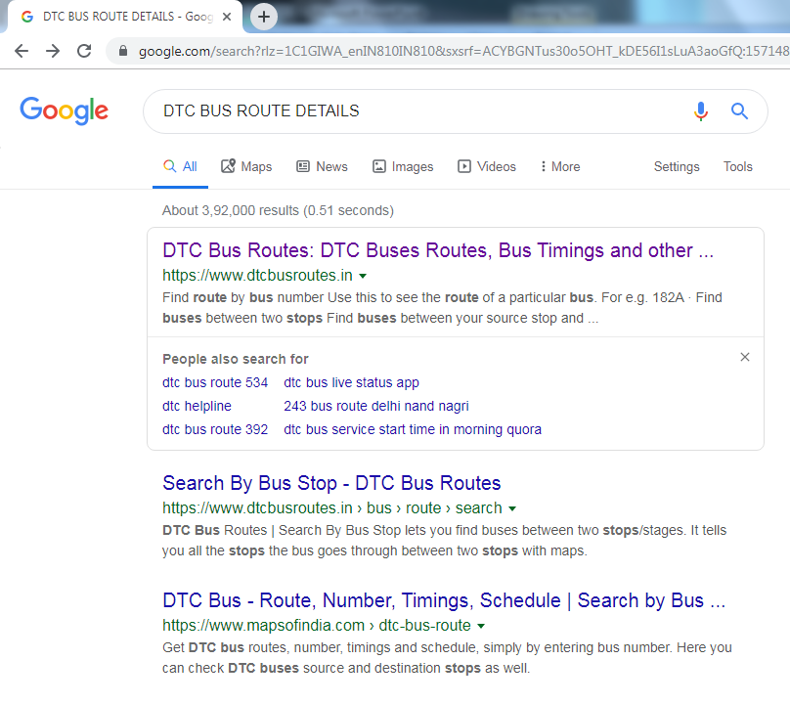
Collection of Data

Slide 5
Collection of Data

Slide 6
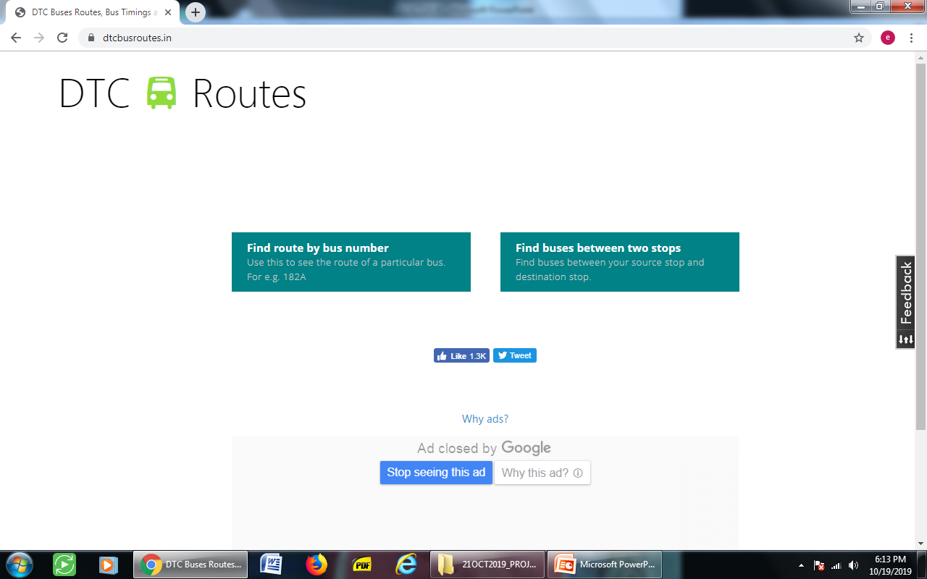
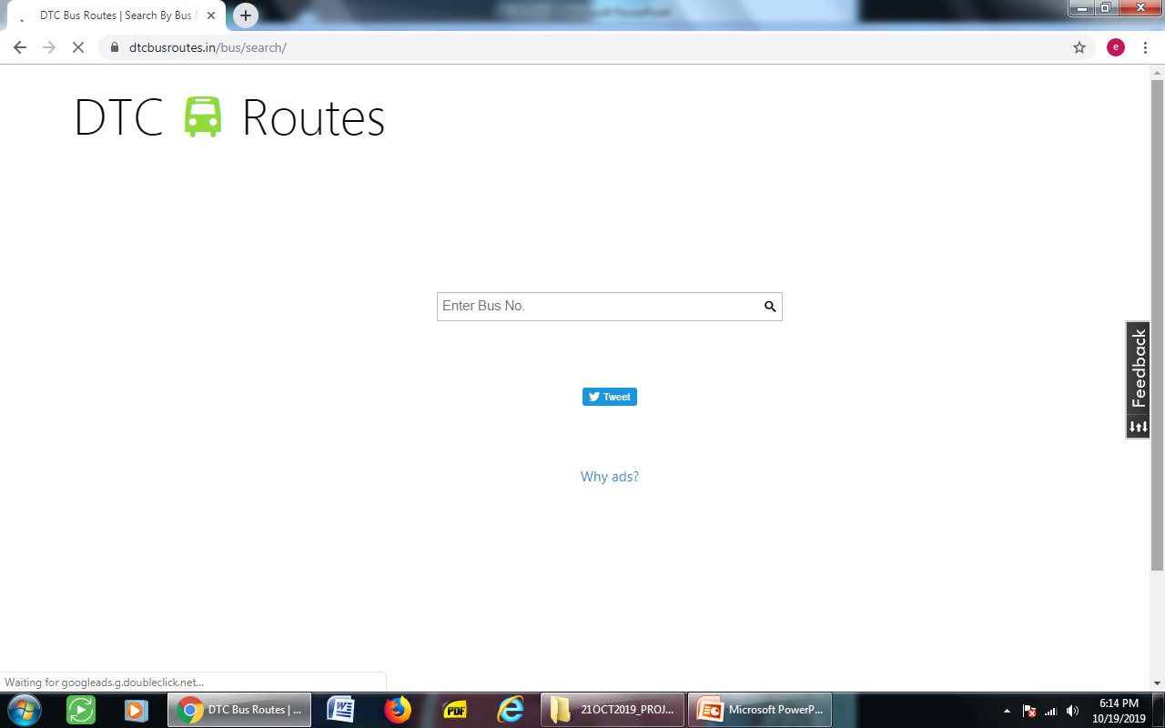
Collection of Data

Slide 7
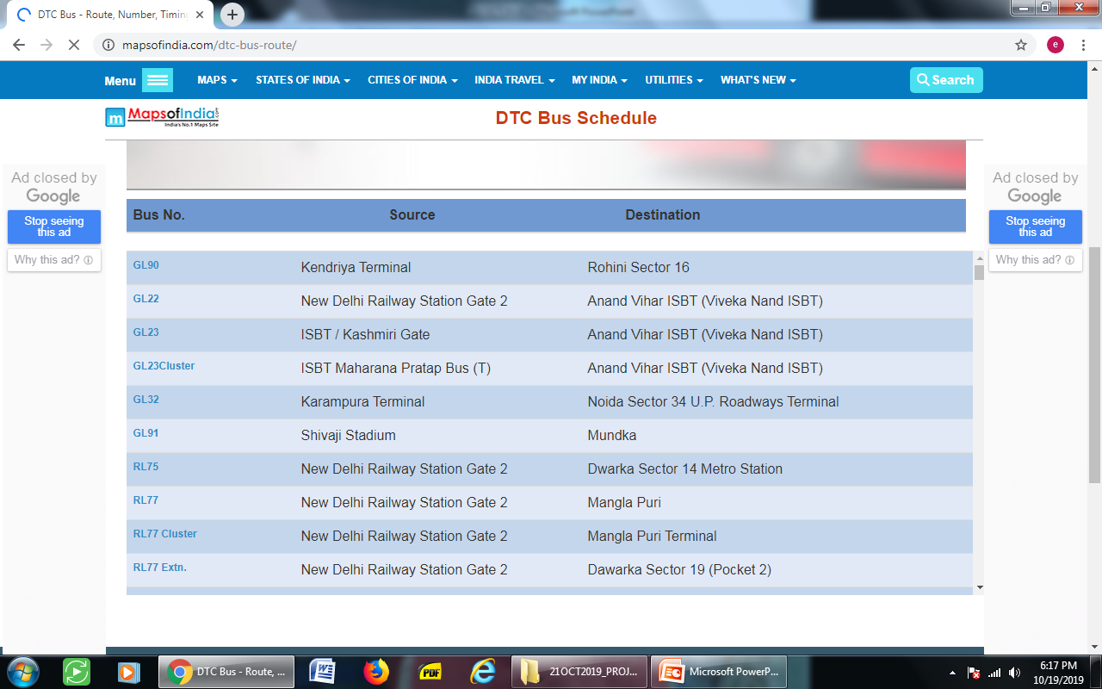
Collection of Data

Slide 8

Collection of Data

Slide 9
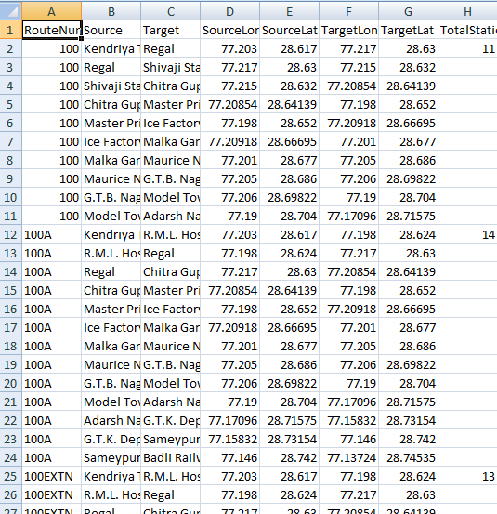
L-Space
Bus Routes - 737
Bus Stops - 1860

Slide 10
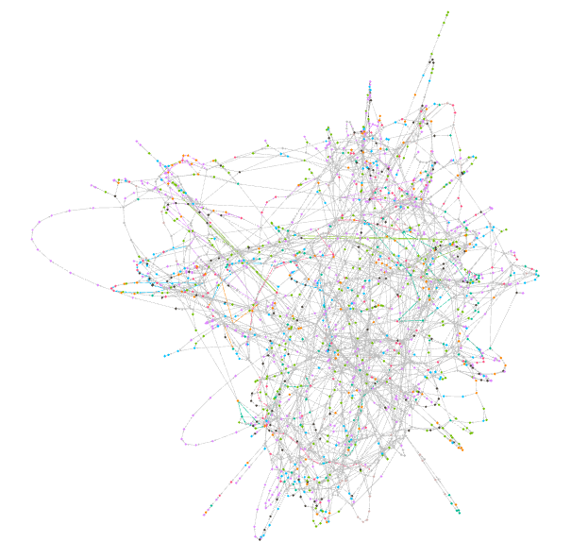
L-Space
Bus Routes - 737
Bus Stops - 1860

Slide 11
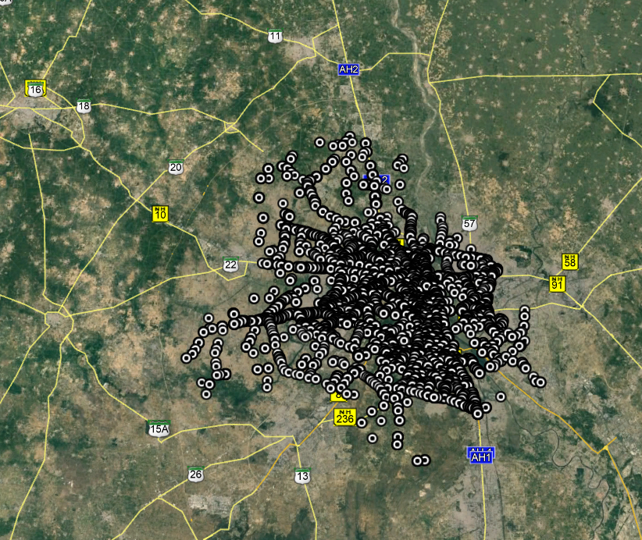
Google Earth View

Slide 12
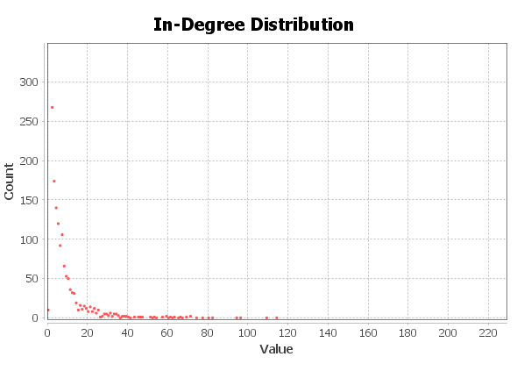
Degree Distribution L Space
A node havinh high degree in L Space simply means it is connected to more number of bus stops.
Potential candidate for Bus Depots or Hub

Slide 13
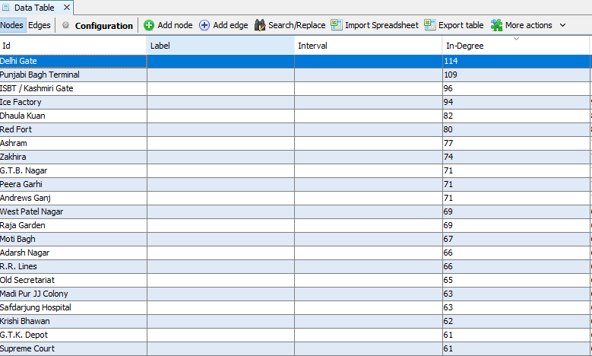
Degree Distribution L Space

Slide 14
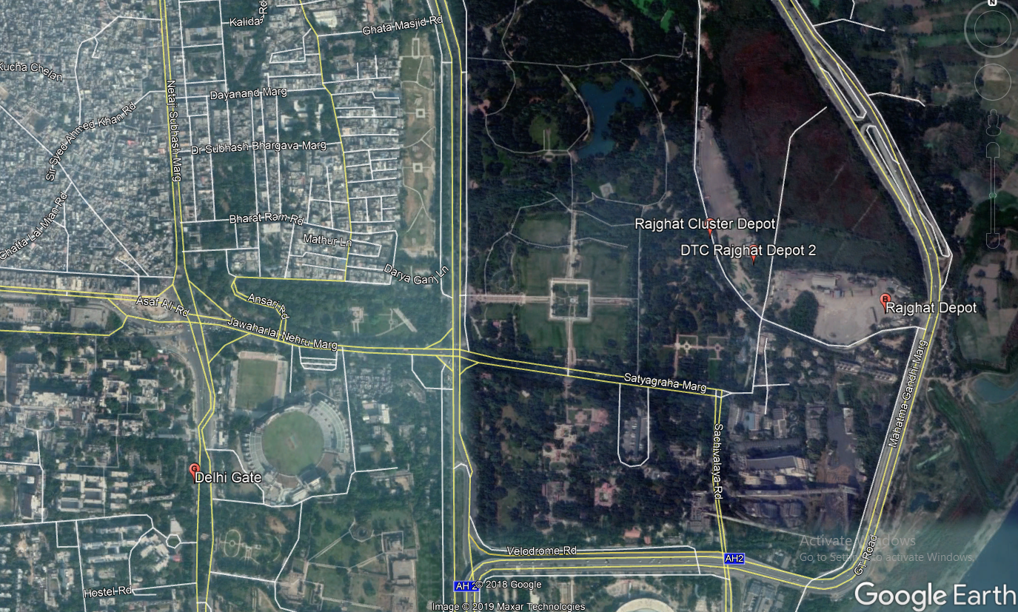
Potential candidate for Bus Depots or Hub

Slide 15
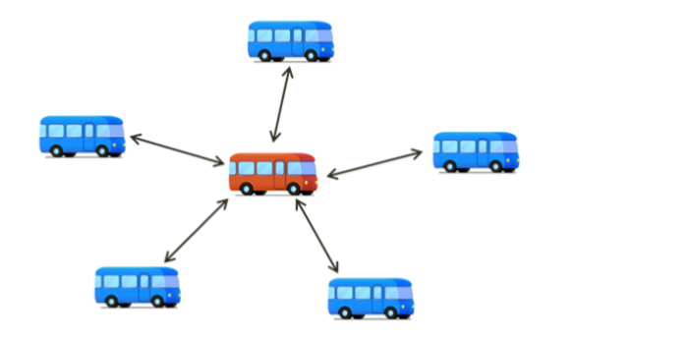
Identification of candidate Bus Routes for Expressway Corridors
Using C Spaces

Slide 16
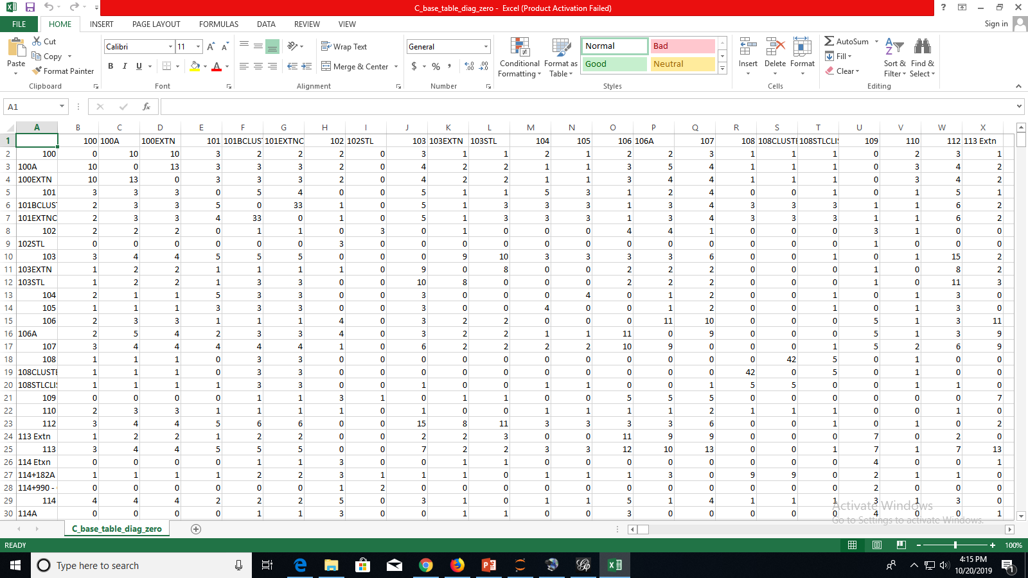
Preparation of C Space

Slide 17
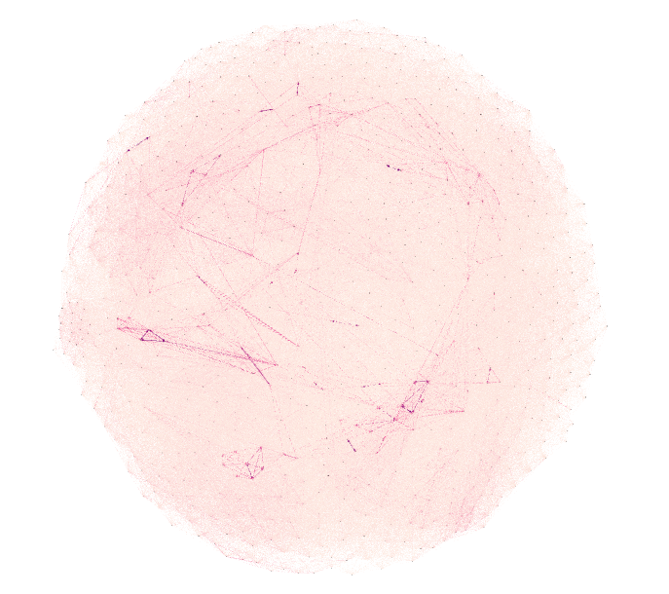
Plot of C Space in Gephi
Nodes:737
Edges: 159992

Slide 18
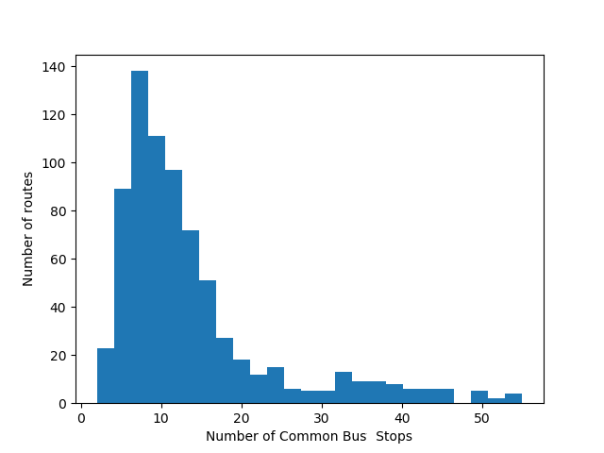
Histogram Plot of C Space

Slide 19
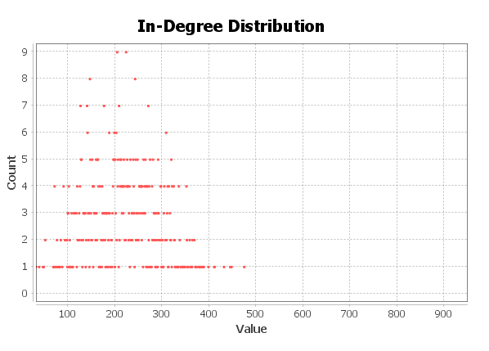
Identification of candidate Bus Routes for Expressway Corridors (How ???)

Slide 20
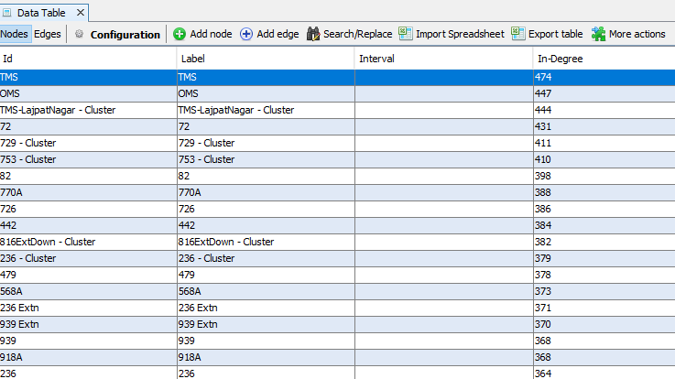
Identification of candidate Bus Routes for Expressway Corridors (How ???)
In C Space, nodes having high degree are best candidate for Expressway Corridors.

Slide 21
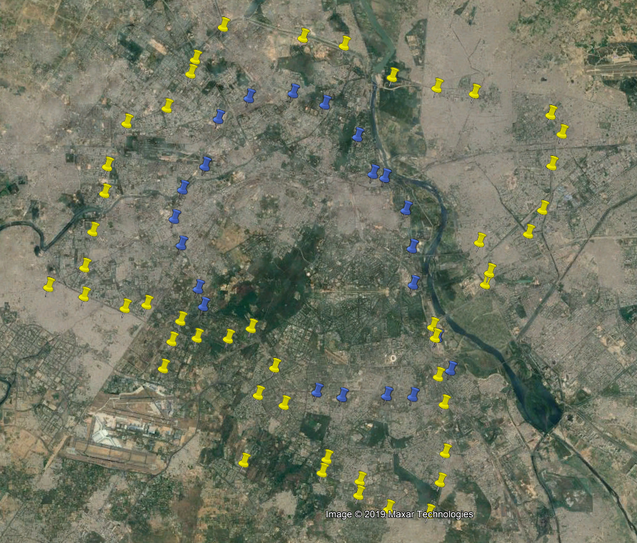
Candidate for Express Highway
TMS Bus Route
OMS Bus Route

Slide 22
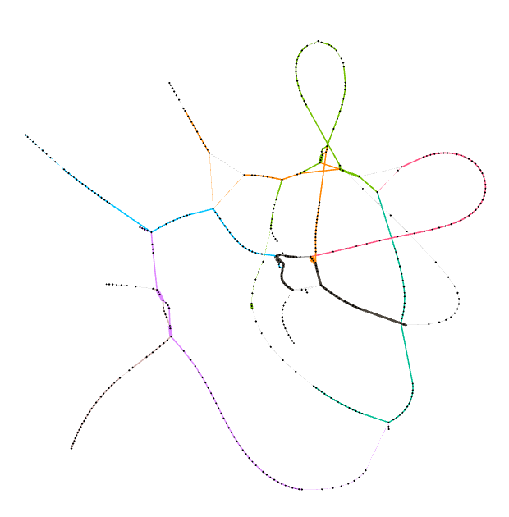

Identification of BRT Routes using Cs Networks
623 Extn: 56
623 Extn Cluster: 67
Cs 55
Cs 43

Slide 23
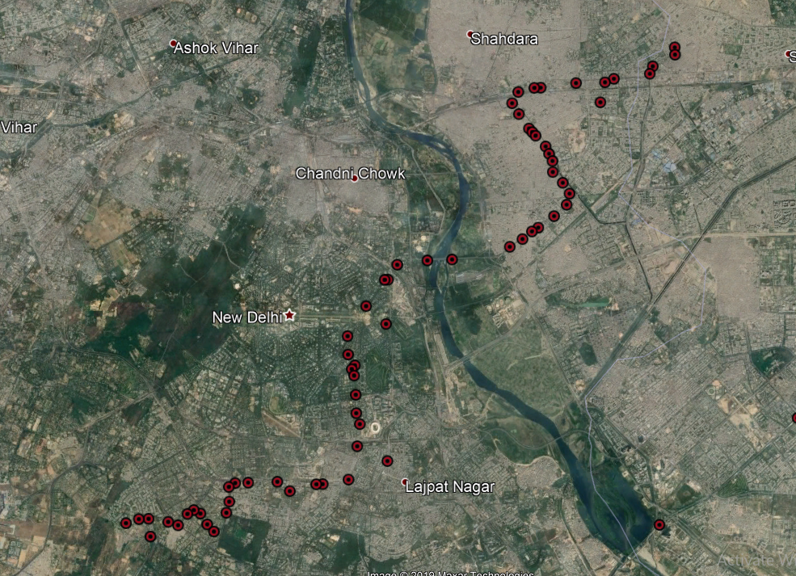
Cs 55 Results 623Extn Cluster

Slide 24
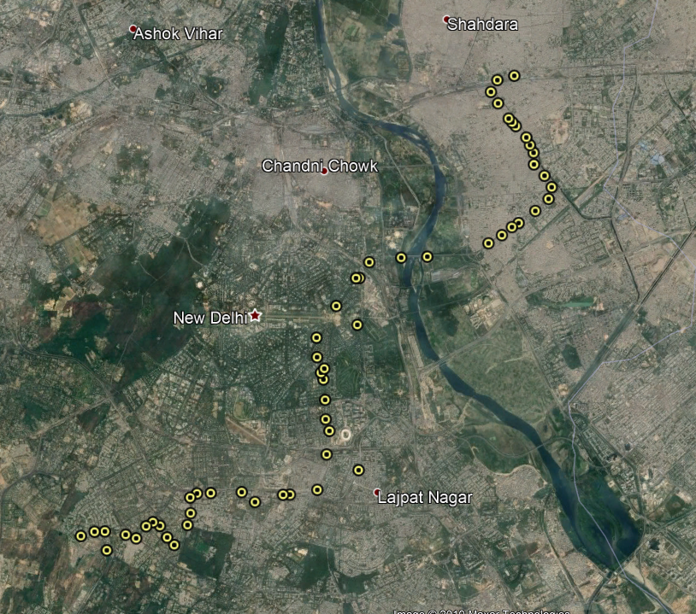
Cs 55 Results 623 Cluster

Slide 25

Identification of BRT Routes using Cs Networks
Bus Route | Number Of Bus Stops
623 Extn | 56
623 Extn Cluster | 67
764 Cluster | 54
764 Extn Cluster | 63
921 CL | 59
921E Cluster | 62
Cs 50

Slide 26
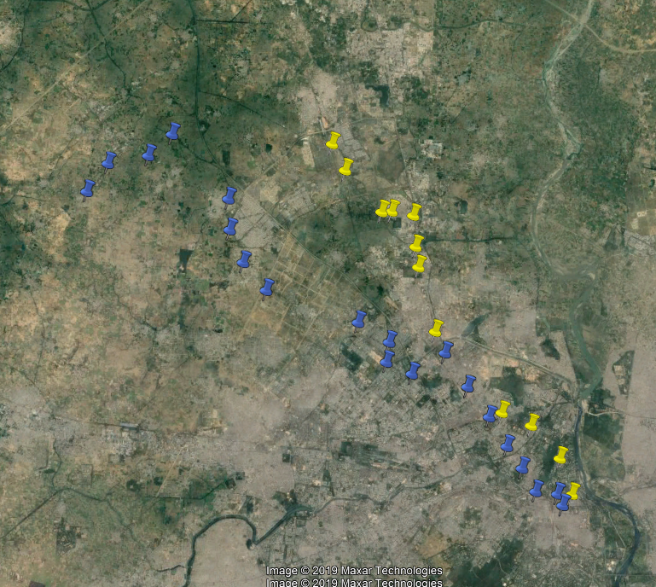
Near 215 degree bus routes

Slide 27
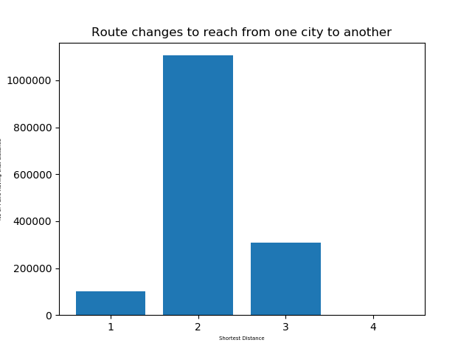
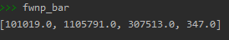

Slide 28
How Many Bus Routes & Bus Stops?
Bus Routes
From Bipartite Graph (B-Space),
Number of Nodes in Bus Routes or Out Degree Nodes
From C Space,
Number of Nodes
Bus Stops
From Bipartite Graph (B-Space),
Number of Nodes in Bus Stops set or In Degree Nodes
From C Space,
Number of Nodes

Slide 29
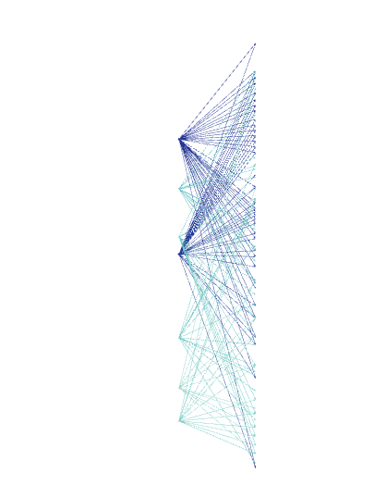
B-Space

Slide 30
Thank You

